Slide 1
Lecture 9: Multilevel modelling 1

Slide 2
The agenda for this lecture
Multiple levels: Macro and micro
Changing two levels to one
Random effects ANOVA
Random intercept multilevel model
GOALS OF THIS LECTURE
To introduce the idea of different levels in research data
To show how aggregating or disaggregating data across levels does not permit confident inference
To extend ANOVA from fixed to random effects
To introduce a random intercept model for grouped data
To show how these models may be fitted using SPSS

Slide 3
Multiple levels: macro & micro
Section 1: Lecture 9
Multilevel modeling
Macro-micro propositions

Slide 4
The right level?
For example: Constructs in organizational psychology:
Are they properties of individuals or properties of the organization?
Some of the history of Organizational climate:
James & Jones (1974): distinguished between psychological (at the individual level) and organizational climate (organizational level)
Subsequent methodological debates:
How to “aggregate” individual measures of psychological climate to measure organizational climate? Is such an aggregation a meaningful organizational collective or simply a statistical artefact?
Glick, 1985; Jackofsky & Slocum, 1990; Payne, 1990
The search for meaningful organizational collectives as a basis for justifying the collective climate construct.
Combination of multi-levels, networks and shared knowledge. Gonzalez-Roma, 1999; Young & Parker, 1999.

Slide 5
Multilevel modeling
Models that permit constructs at more than one level.
Individuals “nested” in groups
Predict individual outcomes from other individual variables as well as group level variables, taking into account the grouping structure
Lower level: micro. Upper level: macro
Macro-level Micro-level
universities lecturers
classes students
neighbourhoods families
firms employees
Jawbones teeth
families children
litters animals
doctors patients
participants measurements
interviewers respondents
Judges suspects
From Snijders & Bosker (2012), p.9

Slide 6
Multilevel modeling
Models that permit constructs at more than one level.
Individuals “nested” in groups
Predict individual outcomes from other individual variables as well as group level variables, taking into account the grouping structure
Lower level: micro. Upper level: macro
The grouping structure sets up dependence among observations.
Sometimes dependence is just a nuisance – you may want independent observations so you can use familiar statistical procedures. But for practical reasons you might need to sample in multiple stages, which can create dependence.
Sometimes dependence in itself is the phenomenon we’re interested in. We want to understand group level effects.

Slide 7
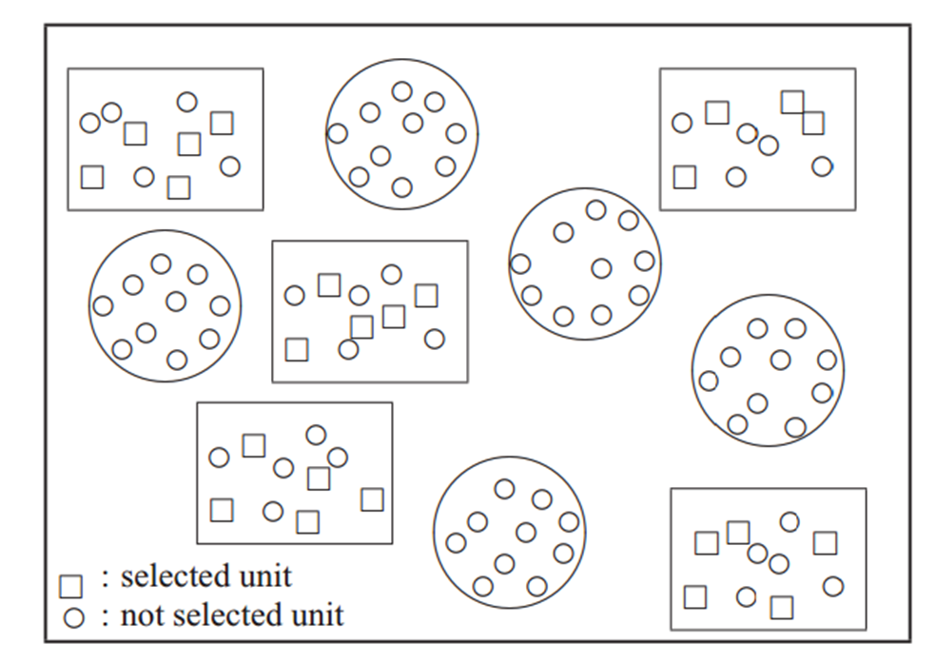
Multistage sampling
Notes:
This diagram is from Snijders and Bosker (2012) p7.

Slide 8
Macro-micro propositions
Macro-micro relations:
Micro-level propositions:
Z
y
x
y
Z
Macro-level propositions:
x
y
Z
Y
Z
x
y

Slide 9
Macro-micro propositions
Micro-macro proposition:
Z
x
A causal macro-micro-micro-macro chain:
W
Z
x
y
(Snijders & Bosker, 2012, p.10-12)

Slide 10
Changing two levels to one
Section 2: Lecture 9
Aggregation
Disaggregation

Slide 11
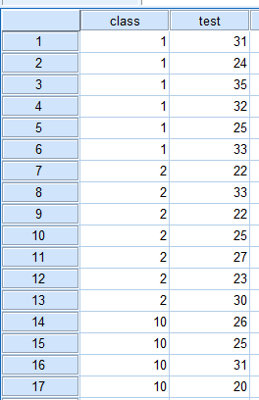
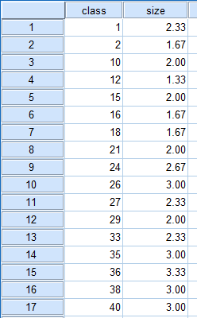
Example of a 2-level structure
Pupils within classrooms:
Variables: test result; classroom size (standardized)
Research question. Do larger classes affect test results?
Pupil data
Class data

Slide 12
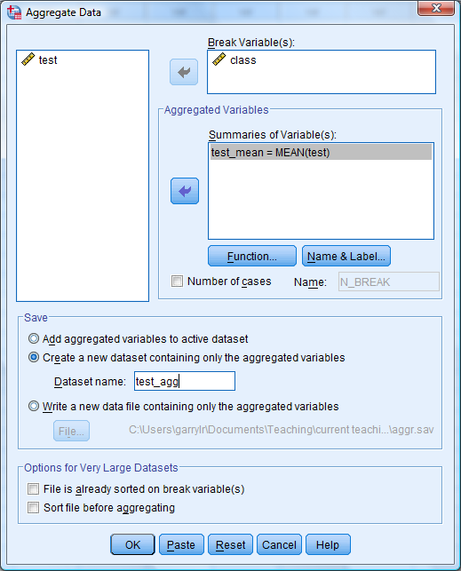
Aggregation
One way to model this is to calculate the means of the test for each class, and then do a regression at the classroom level
SPSS Menus: Data -> Aggregate ...
The Break variable describes how to break the dataset to create means. In this case we want means of test within classes
We want the mean of ‘test’ for each class.
We want to save to a new dataset.

Slide 13
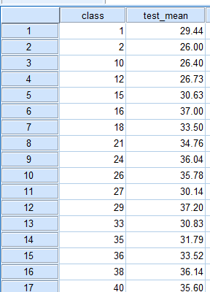
Aggregation
One way to model this is to calculate the means of the test for each class, and then do a regression at the classroom level
Class data
Resulting file is at the class level.
Need to combine with the other class level file containing the size variable
SPSS Menus: Data -> Merge Files -> Add variables...
(then select your other dataset)

Slide 14
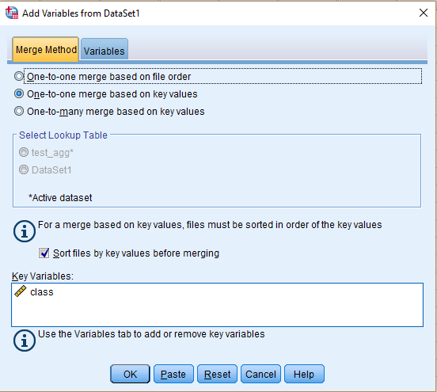
Aggregation
One way to model this is to calculate the means of the test for each class, and then do a regression at the classroom level
SPSS Menus: Data -> Merge Files -> Add variables...
We are doing a
One-to-one merge based on key values (SPSS will default select this anyway)

Slide 15
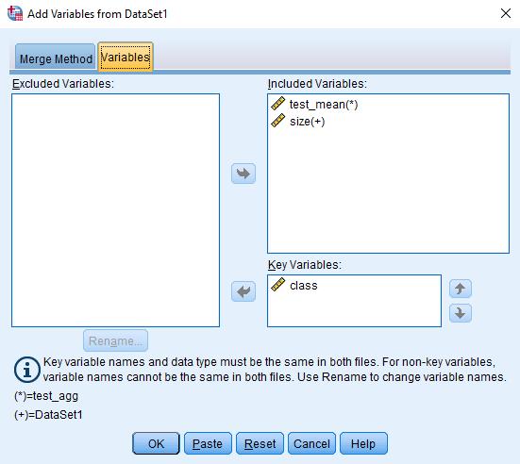
Aggregation
One way to model this is to calculate the means of the test for each class, and then do a regression at the classroom level
SPSS Menus: Data -> Merge Files -> Add variables...
Class is the variable that is identical across the two files. You need to match on this variable.

Slide 16
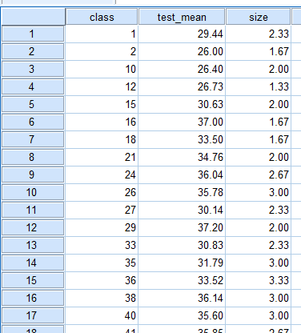
Aggregation
One way to model this is to calculate the means of the test for each class, and then do a regression at the classroom level
Class data

Slide 17
Aggregation
Aggregation is OK if you are only interested in macro-level propositions but there is potential for gross errors for micro-level or macro-micro propositions.
shift of meaning: We are no longer predicting student’s test scores, but average test scores.
neglect of original data structure (between groups relations may even be opposite to within group relations)
prevents examination of cross-level interactions
ecological fallacy: You cannot infer that an association at a macro level translates into an association at micro level
danger of aggregation bias: (possible to get inflated statistical effects if analyses based on means are interpreted as relating to individuals – James, 1982)

Slide 18
Disaggregation
Another way to proceed is to apply the class size variable to each student and conduct a regression at pupil level
Because class is the variable that links both files, it is good practice to sort the cases first, so that the key variable is in the same order in both files
Data -> Sort cases ...
Sort by class in Ascending order
(Do this for both files)

Slide 19
Disaggregation
Another way to proceed is to apply the class size variable to each student and conduct a regression at pupil level
After sorting the cases, return to the pupil level datafile (the micro file)
Data -> Merge files -> Add variables
Select the class level (macro-level) dataset to merge

Slide 20
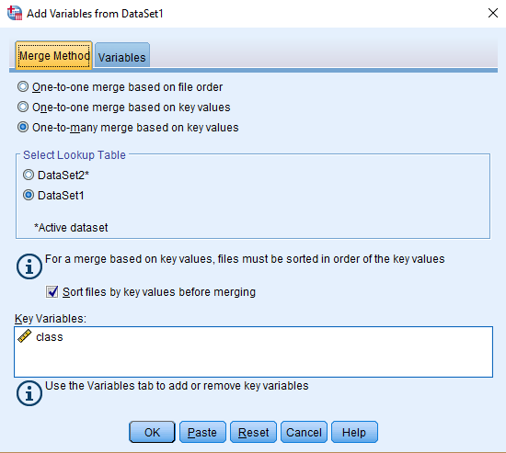
Disaggregation
Another way to proceed is to apply the class size variable to each student and conduct a regression at pupil level
Just as before,
...except now

Slide 21

Disaggregation
Another way to proceed is to apply the class size variable to each student and conduct a regression at pupil level
Pupil data
So, does class size affect test score? Contradictory results

Slide 22
Issues for Disaggregation
measure of macro-level variable considered as micro-level
miraculous multiplication of the number of units
risks of type 1 errors
Do not take into account that observations within a macro-unit could be correlated.
Snijders & Bosker (p.17) conclude:
“… if the macro-units have any meaningful relation with the phenomenon under study, analysing only aggregated or disaggregated data is apt to lead to misleading and erroneous conclusions. A multi-level approach, in which within-group and between-group relations are combined, is more difficult but much more productive.”

Slide 23
Random effects anova
Section 3: Lecture 9
General Linear Model: Regression and Random effects ANOVA
Using SPSS
Intra class correlation

Slide 24
General linear model: regression & ANOVA
Standard regression model: Y_{i} = β₀ + β₁X_{i} + ε_{i}
where Y_{i} is the outcome variable for the i-th case;
X_{i} is the predictor variable for the i-th case;
β₀ is the constant or intercept;
β₁ is the regression coefficient for X_{i};
and ε_{i} is the residual for the i-th case.
Assume that ε_{i} is normally distributed with mean 0 and variance σ²
Multiple regression: Y_{i} = β₀ + ∑β_{k}X_{ki} + ε_{i}
where the X_{ki} are P predictor variables
Y = β₀ + β₁X₁ + β₂X₂ + ... + β_{p}X_{p} + ε

Slide 25
General linear model: regression & ANOVA
Multiple regression: Y_{i} = β₀ + ∑β_{k}X_{ki} + ε_{i}
Suppose that the cases are divided into P groups and that the X_{ki} are dummy variables (0,1) indicating group membership:
i.e. X_{ij} = 1 if i-th case is in group j
X_{ij} = 0 otherwise.
Y_{ij} = β₀ + ∑β_{k}X_{ki} + ε_{ij}
One-Way ANOVA: Y_{ij} = β₀ + β_{j} + ε_{ij}
where Y_{ij} is the outcome variable for i-th case in j-th group.
Define β₀ + β_{j} = β_{0j}
Y_{ij} = β_{0j} + ε_{ij}

Slide 26
Random effects ANOVA
For fixed effects ANOVA, we assume that the groups refer to categories, each with its own distinct interpretation.
e.g. gender, religious denomination, treatment vs control groups.
But sometimes the groups are samples from a population (actual or hypothetical) of possible macro-units.
e.g. three treatment groups based on different levels of drug intake
e.g. a study comparing five workteams within an organisation.
In this case, β_{0j} is not a fixed, but a random factor.
Set β_{0j} = γ₀₀ + u_{0j} to denote this situation,
with γ₀₀ a fixed effect (the intercept)
u_{0j} is assumed normally distributed with mean of 0 and variance τ².
Random effects ANOVA:
Y_{ij} = γ₀₀ + u_{0j} + ε_{ij}

Slide 27
Random effects ANOVA
Random effects ANOVA:
Y_{ij} = γ₀₀ + u_{0j} + ε_{ij}
Notice that for a random effects ANOVA, there are two sources of variance.
u_{0j} assumed normally distributed with mean of 0 and variance τ².
ε_{ij} assumed normally distributed with mean 0 and variance σ²
Total variance of Y_{ij} = τ² + σ²
τ² is the variance due to the group structure
σ² is the residual variance
In effect, the intercept varies across all groups by an amount u_{0j} for group j. So the j-th group has intercept γ₀₀ + u_{0j} . The variance of the intercept term across all groups is τ² .

Slide 28
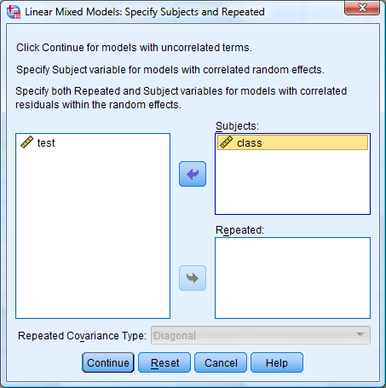
SPSS: Random effects ANOVA
Pupil data
Analyze -> Mixed Models -> Linear...
Cases grouped within class

Slide 29
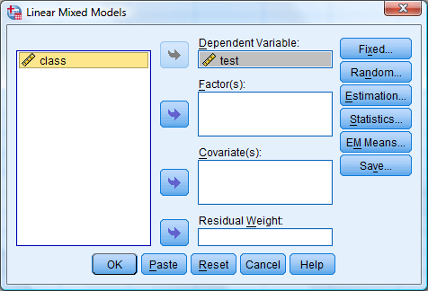
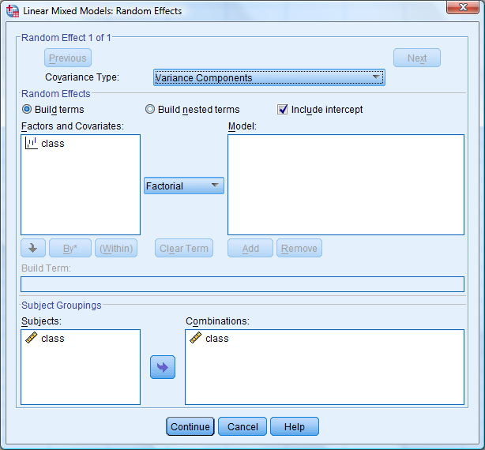
SPSS: Random effects ANOVA
DV is the test score
There is an intercept in our model
Class is our random subject grouping

Slide 30
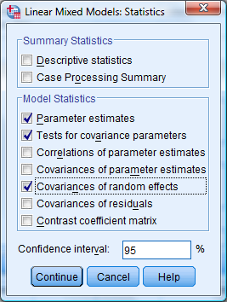
SPSS: Random effects ANOVA
Under statistics, choose at least:
Parameter estimates
Tests for covariance parameters
Covariances of randfom effects

Slide 31
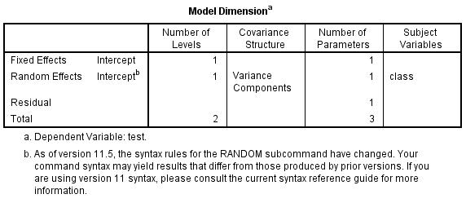
Output: Random effects ANOVA
Model dimension sets out the shape of the data.
One fixed effect (the fixed intercept γ₀₀)
One random effect (the variance of the intercept u_{0j})
One residual effect
Variance components simply divides the variance into these two components

Slide 32
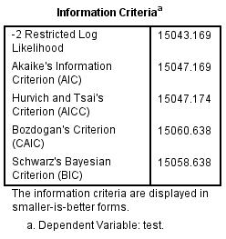
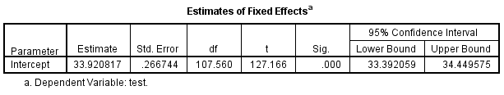
Output : Random effects ANOVA
These are various measures of fit, which are not much use unless comparing two models which we are not doing here.
The fixed effect γ₀₀. The estimate is 33.9.
It is significantly different from 0.

Slide 33
Intra class correlation
The ICC is the proportion of variance explained by the group structure.
It is also the correlation between two randomly drawn individuals in one randomly drawn group.
There are several ICCs – the one we are dealing with today is also often called ICC(1) – McGraw & Wong, 1996.
Random effects ANOVA:
Y_{ij} = γ₀₀ + u_{0j} + ε_{ij}
Variance of intercept = var (γ₀₀ + u_{0j} ) = var (u_{0j}) = variance due to group structure
Variance due to residual = var (ε_{ij} )
Total variance = var (u_{0j}) + var (ε_{ij} )
ICC = var (u_{0j}) / total variance = var (u_{0j}) / [var (u_{0j}) + var (ε_{ij})]
The proportion of variance explained by the group level

Slide 34
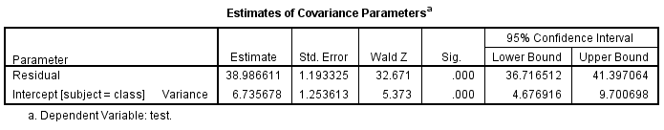
Output : Random effects ANOVA
Random effects ANOVA:
Variance of intercept = var (u_{0j}) = 6.74
Variance due to residual = 38.99
Total variance = 6.74 + 38.99 = 45.73
ICC = var (u_{0j}) / total variance = 6.74 / 45.73 = 0.147
So 14.7% of variance in test score is due to the group structure
The intercept variance is significant.
The ICC at 14.7% is greater than 5% (used as a rough cut-off value).
So, the group structure is important to explaining test scores – this argues in favour of doing multilevel modelling.

Slide 35
Random intercept multilevel model
Section 4: Lecture 9
Hierarchical Linear Models
Random intercept: The null model
Random intercept with one predictor

Slide 36
Hierarchical Linear Models Multilevel models
A two stage strategy to investigate variables at two levels of analysis.
Level 1: relationships among level 1 variables estimated separately for each higher level (level 2) unit.
These relationships are then used as outcome variables for the variables at level 2.

Slide 37
Example (Heck et al, 2014)
Students nested within schools
Dataset contains a number of variables including:
Maths test score
Student socio-economic status (a standardised continuous measure).
Is SES associated with performance on the maths test?

Slide 38
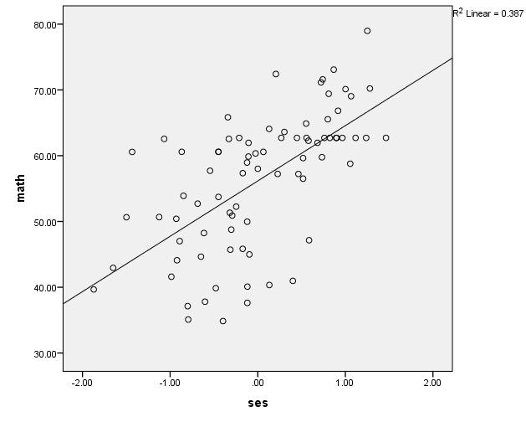
One regression model
Assumes the one model for all schools

Slide 39
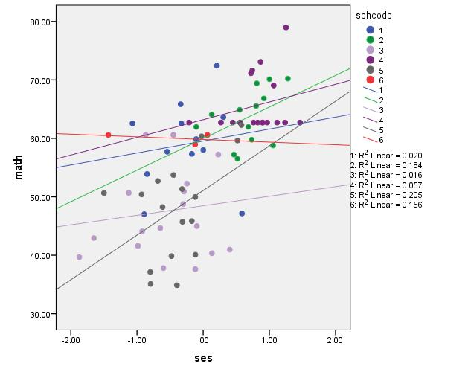
Regression models for each class
Different slopes
Different intercepts:
Multilevel models assume that these intercepts are normally distributed around a mean value
Different linear models for 6 different schools

Slide 40
Random intercept model with one Level 1 predictor
Random intercept model treats the intercepts as random but has a fixed effect for slope.
Level 1 equation: Y_{ij} = β_{0j} + β₁ (SES) _{ij} + ε_{ij}
Level 2 equations: β_{0j} = γ₀₀ + u_{0j}
β₁ = γ₁₀
So that Y_{ij} = γ₀₀ + γ₁₀ (SES) _{ij} + u_{0j} + ε_{ij}
Random intercept
Fixed slope
Notice that if we ignore the predictor SES (ie set γ₁₀ = 0), then we have the random effects ANOVA – the null model

Slide 41
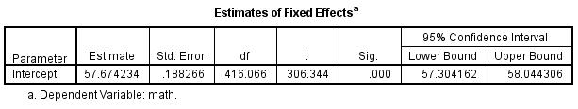
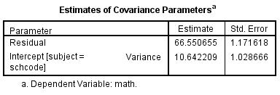
Variance components for null model
ICC = 0.138

Slide 42
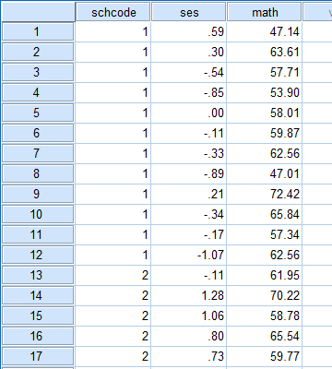
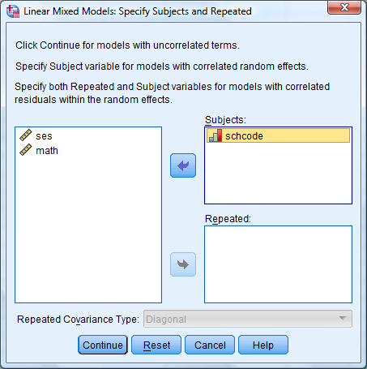
Random intercept model Predicting math from ses
Analyze -> Mixed Models -> Linear...
Cases grouped within school
schcode is the code number for each school

Slide 43
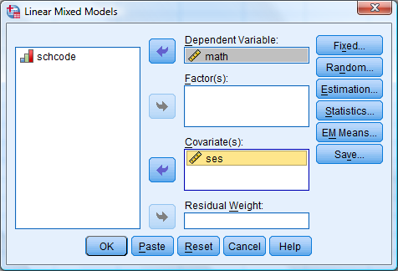
Random intercept model Predicting math from ses
Predicting math
from SES

Slide 44
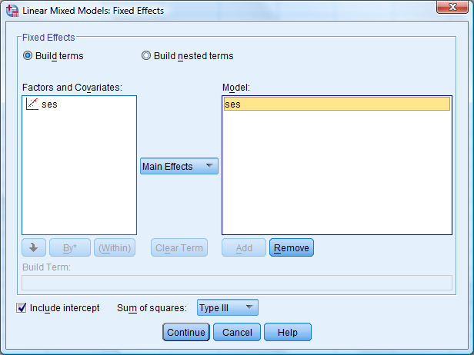
Random intercept model Predicting math from ses
SES is a fixed Main effect

Slide 45
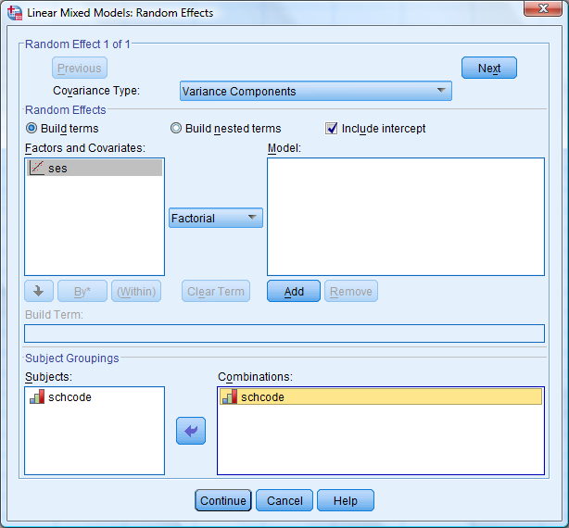
Random intercept model Predicting math from ses
Stick with variance components
Include an intercept
schcode is the grouping variable

Slide 46
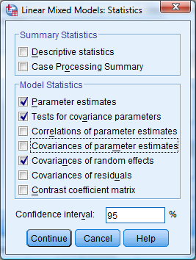
Random intercept model Predicting math from ses
Check that restricted maximum likelihood is used
Select at least these statistics

Slide 47
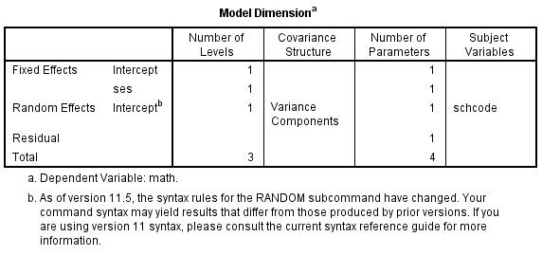
Output
Model dimension sets out the shape of the data.
Two fixed effects (the fixed intercept γ₀₀ and fixed slope for ses)
One random effect (the variance of the intercept u_{0j})
One residual effect
Four parameters: Y_{ij} = γ₀₀ + γ₁₀ (SES) _{ij} + u_{0j} + ε_{ij}

Slide 48
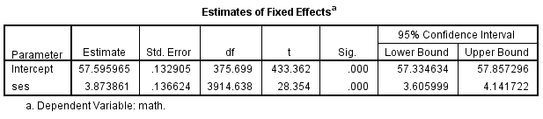
Output
Estimates for fixed effects:
Estimate for fixed intercept γ₀₀ = 57.60
Estimate for slope of ses, γ₁₀ = 3.87
Both are significant.
Four parameters: Y_{ij} = γ₀₀ + γ₁₀ (SES) _{ij} + u_{0j} + ε_{ij}
Significant positive slope for ses predicting math

Slide 49
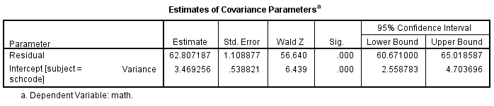
Output
Variance:
Previous intercept variance for null model = 10.64
Intercept variance for current model = 3.47
Reduction of variance from null model = (10.64-3.47)/10.64
= 67%
So SES accounts for 67% of between group variance
ICC = 3.47/(3.47+62.81) = 0.05 – much reduced compared to null model.

Slide 50
Summary
IN THIS LECTURE, you
were introduced to the idea of multilevel research
learnt how aggregating or disaggregating data across levels is not the best way to deal with multilevel data
learnt about random effects ANOVA
Were introduced to a random intercept model for grouped data
learnt how to fit these models in SPSS

Slide 51
References
Books:
Heck, Thomas & Tabata (2014). Multilevel and longitudinal modeling with IBM SPSS. Routledge. (chaps 2,3).
Snijders, T., & Bosker, R. (2012). Multilevel analysis: An introduction to basic and advanced multilevel modeling. London: Sage.
Articles
James, L.R. (1982). Aggregation bias in estimates of perceptual agreement. Journal of Applied Psychology, 67, 219-229
McGraw, K.O., & Wong, S.P. (1996). Forming inferences about some intraclass correlation coefficients. Psychological Methods, 1, 30-46.
Organizational climate
Glick, W.H. (1985). Conceptualizing and measuring organizational and psychological climate: pitfalls in multilevel research. Academy of Management Review, 10, 601-616.
Gonzalez-Roma, V., et al. (1999). The validity of collective climates. Journal of Occupational & Organizational Psychology, 72, 25-40.
Jackofsky, E.F. & Slocum, J.W. (1990). Rejoinder to Payne's comment on ‘A longitudinal study of climates’. Journal of Organizational Behavior, 11, 81-83.
James, L.R., & Jones, A.P. (1974). Organizational climate: A review of theory and research. Psychological Bulletin, 81, 1096-1112.
Payne, R. (1990). Madness in our method. A comment on Jackofsky and Slocum’s paper, ‘A longitudinal study of climates’. Journal of Organizational Behavior, 11, 77-80.
Young. S.A. & Parker, C.P. (1999). Predicting collective climates: assessing the role of shared work values, needs, employee interaction and work group membership. Journal of Organizational Behavior, 20, 1199-1218.

